Slide 1
Smart House
Engineering Adaptive Mobile Applications
Anastasia Lykhtar, Dmitriy Monakhov

Slide 2
Problem of daily routines
Apartments become bigger…
User’s time becomes more valuable
We want to make domestic activities easier…
And give the user information about his domestic environment…
Accessible at any place!

Slide 3
Who is interested?
Any homeowner wants to make some action automatic.
Why is it so dark? Where is the switch?!
What is the current temperature here? I want A/C on!
What is the current humidity? I want dry air!
Nowadays we need to do all this manually.
Smart House will do your job!
Target user group: Owner of a big house/flat

Slide 4
Target personas. Student
Age: 22 - 23
Activity: Master-student
Family: Single
Place of living: Dresden (private apartment)
Income: 0
Hobbies: IT, Electronics
Internet activity: Daily
Working experience: Software Development
Daily tasks: Studying, room cleaning, cooking, washing
Expectations: Easy to use daily tasks automation tools

Slide 5
Target personas. Homeowner
Age: 45
Activity: Senior Software Developer
Family: Married
Place of living: Dresden (private house)
Income: 60000 EUR per year
Hobbies: IT, Electronics
Internet activity: Daily
Working experience: Software Design
Daily tasks: Work, house keeping
Expectations: Make daily tasks faster

Slide 6
Key functions
Light control
Reading Appliance state
Remote control of appliance
Automation scenarios
Authorization. Separation of roles
Reading sensor data

Slide 7
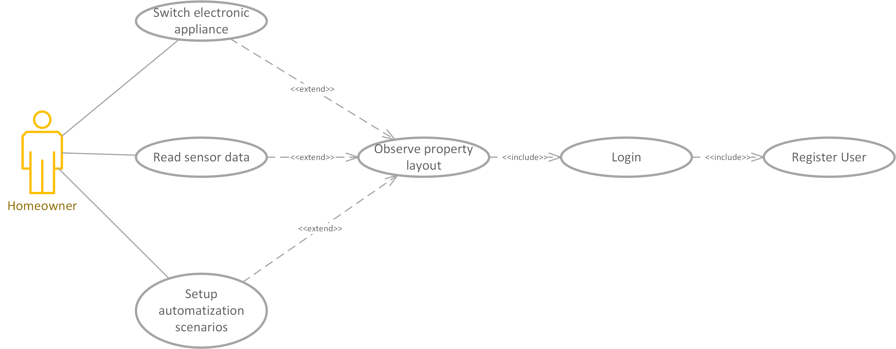
Use Cases

Slide 8
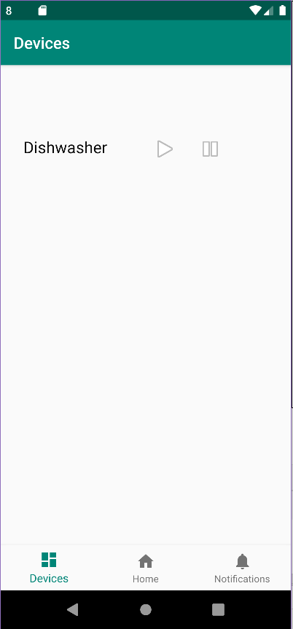
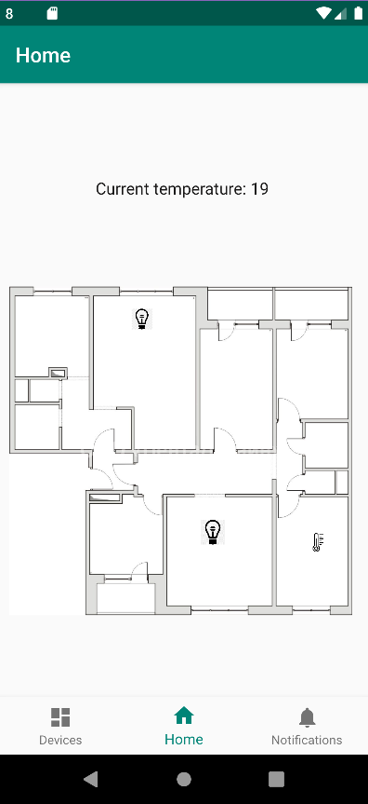
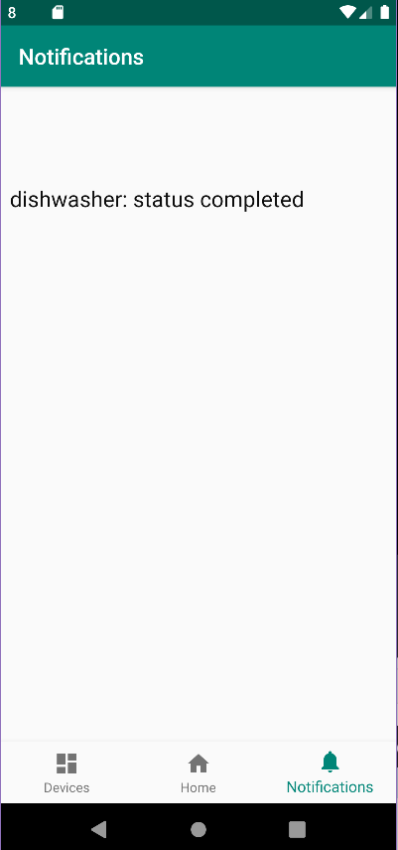
UI Mockup

Slide 9
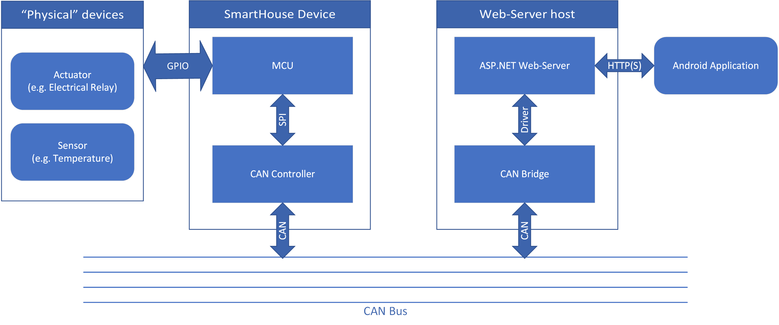
Hardware Structure diagram

Slide 10
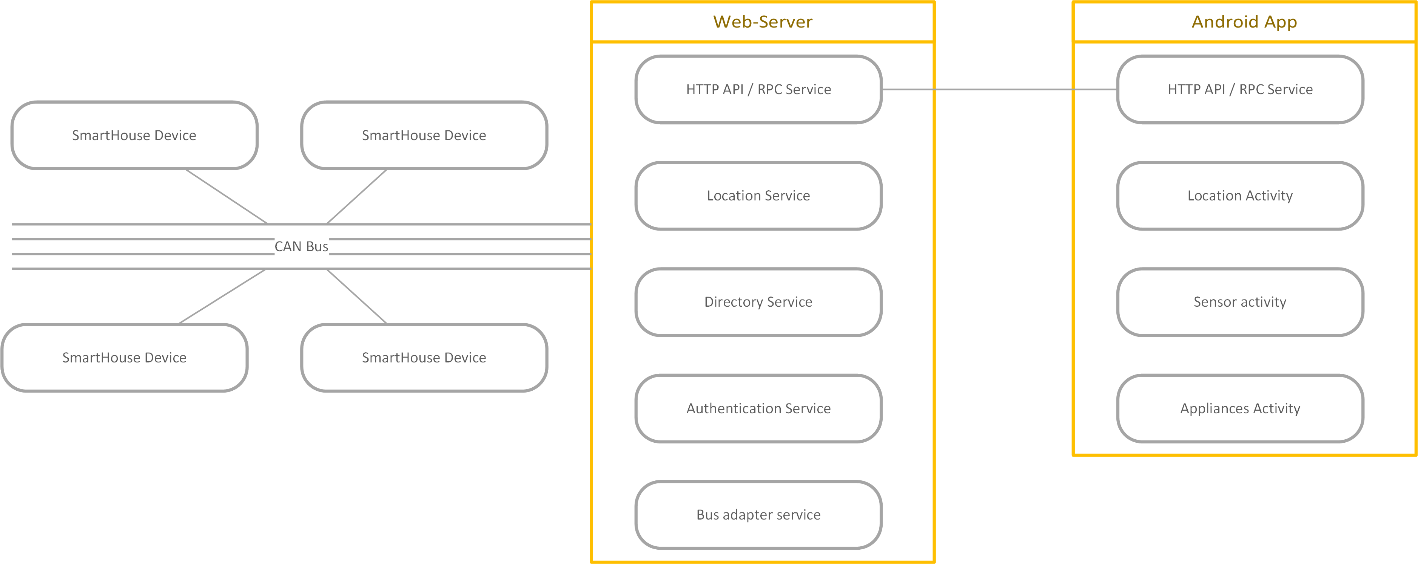
Software Component Structure diagram

Slide 11
Connectivity challenge
What if the user is not at home, but still wants to control the Smart House?
We need to handle transition between LAN and WAN.
We need to ensure security while user is in WAN.
No one unauthorized should control the house!

Slide 12
Offline Challenge
Client application can store the apartment layout locally.
Client application can cache last state of switches or sensors.
Client application can enable deferred actions.

Slide 13
Energy challenge
Mobile app must do as little work as possible.
All heavy jobs are the server's responsibility.

Slide 14
Usability Challenge
Show current room on startup based on location
Show different functions depending on user’s role (adult, kid, guest)
Hide privileged functions depending on user’s privilege level

Slide 15
Context Awareness and Adaptation
Do stuff automatically depending on user location (turn lights on/off, read appropriate temperature sensor, etc.)
But GPS does not work inside buildings or it’s accuracy is too bad.
We can use Wi-Fi positioning to determine current room.
E.g. location is a function of Wi-Fi AP SSID (every room has its own AP)

